Slide 1

Project Federated CRM
Incognito Mode

Slide 2

Introduction
Project Description
Project Scope
Project Purpose
Notes:
Project Description : Replace the CRM system with a better interface. Put everything in one location to make it easier.
Project Purpose : Update the current CRM system to replace aging technology. By maintaining customer data whilst making it easier for the sale reps to access database information
Project Scope : Integrate a CRM system by creating a database for client profiles, creating a user effective system, creating an ERD and database that will follow the ERD, and creating an interface that will incorporate needs for the users such as a time management system, calendar, and a client system.

Slide 3
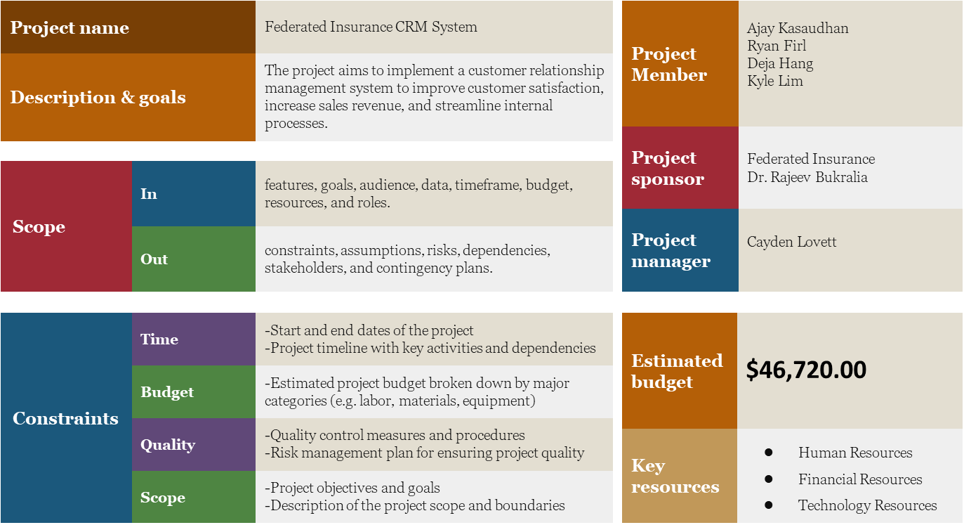
Project Charter

Slide 4
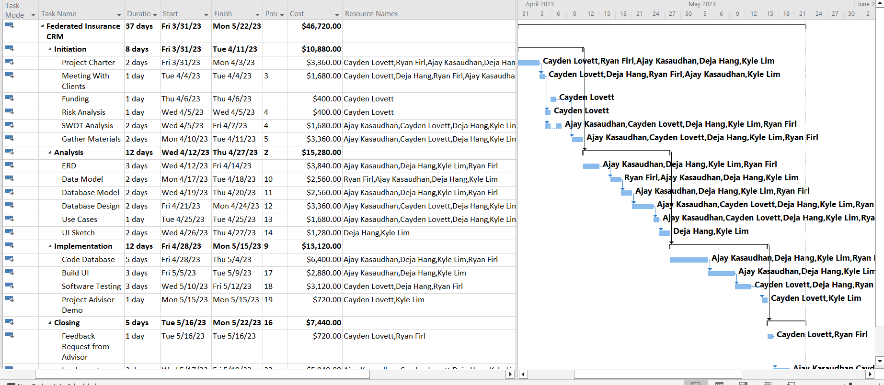
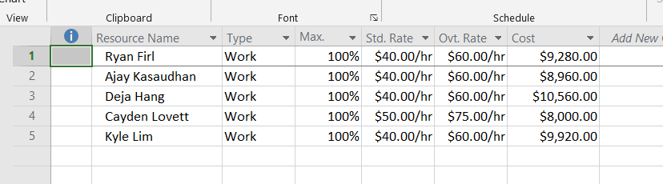
WBS & Gantt Chart

Slide 5
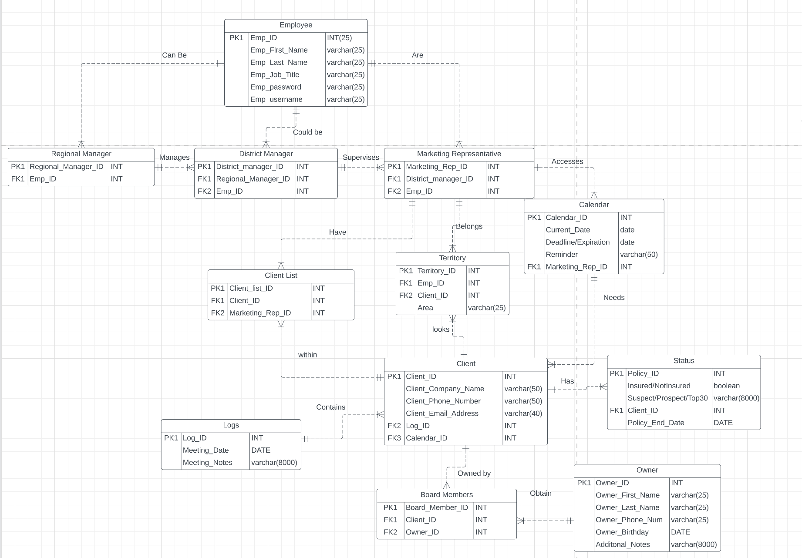
ERD

Slide 6

Functional Database
Demo

Slide 7

Deployment method
Parallel Operation
Old and new system run concurrently
Lower Risk
Can use old system as back up

Slide 8
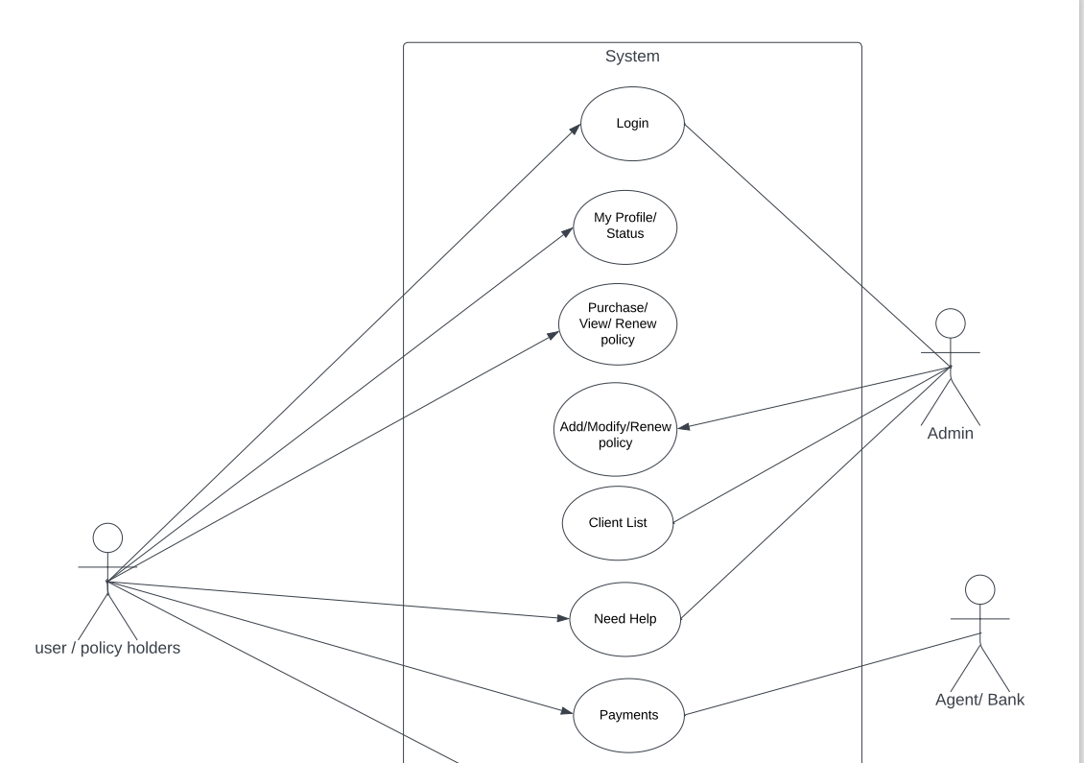
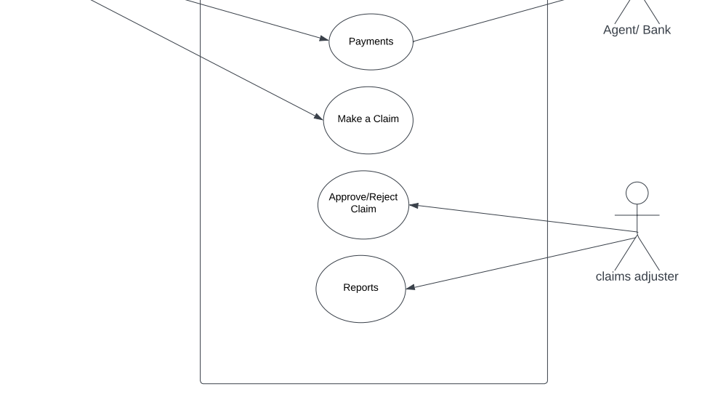
Use Case Diagrams

Slide 9
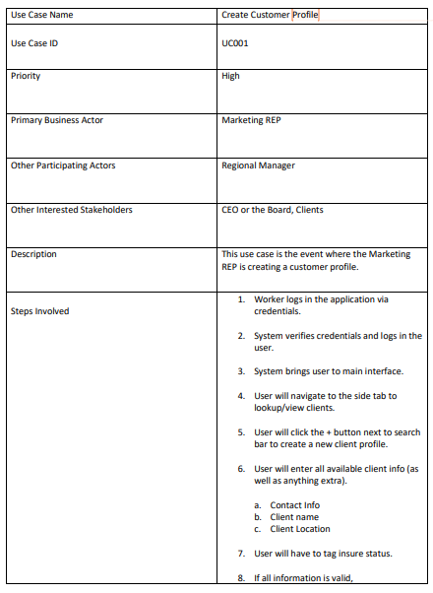
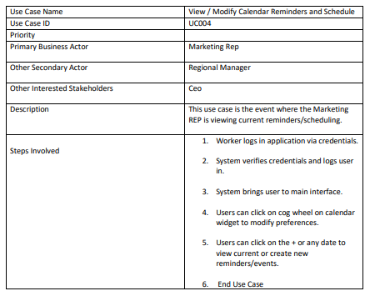
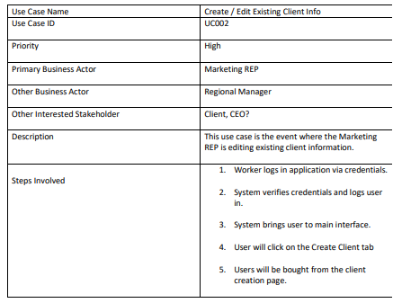
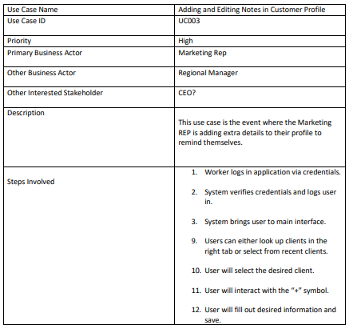
Use Cases

Slide 10
Interface Demo
Demo

Slide 11
Conclusion
What is a CRM system?
Learning regarding the project.
Learning regarding group work.
Notes:
What is a CRM system? : Software system that helps keep track, manage, and store information regarding clients, such as suspects, prospects, and the top 15 or 30 clients, into one system.
Learning progress : We learned many things in relation to the project, everything relating to the project was almost something new, such as the use cases, WBS & Gantt chart, and the project charter.
Learning outside : Regarding group work primarily. We learned many things during our group work, there are many things we have to accommodate for such as each person’s schedule or knowing the knowledge level that we each have. Overall, we had a very progressive and effective group work process, there were a few times where communication was a problem.

